Slide 1





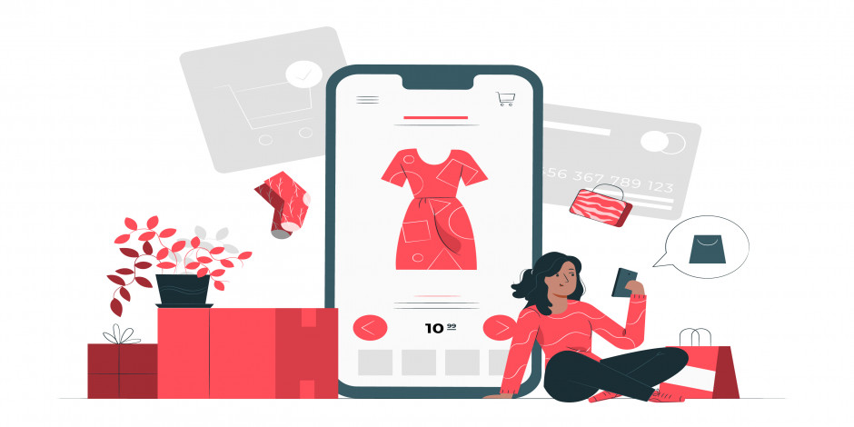
IBM Hack Challenge 2021 in collaboration with AICTE powered by SmartInternz
Fashion Redefined with Virtual Grooming & Shopping Assistant
Challenge Title : Hack Challenge 2021
Project ID: SPS_PRO_2077
Team Name : Squad Bugs
Mentor Name : Tulasi, Hemanth Kumar Gahlot
PRESENTED BY:
KALLISH KUMAR N
RISHII KP
SAGAYASREE Z
SUSHANTH ARUNACHALAM

Slide 2
INTRODUCTION
Technology is improving at its peak and everything is digitalized now-a-days.
Fashion is now considered to be one of the most important aspects in everyone’s life.
The major problem is that finding a proper costume that suits an individual’s interest and looks.
Providing fashion trends that suits for every occasion is also considered to be another problem for everyone.

Slide 3
PROBLEM AND PROPOSED SOLUTION
Providing fashion trends for each individual is not easy, since everyone has their own interest and looks that match them.
AI related technology can help us in providing fashion trends as per the user’s requirement.
IBM’s chatbot (Watson Assistant) helps in providing suggestions by collecting various parameters for user satisfaction.
An online platform that suggest fashion trends by using Watson assistant and also by using Deep learning model.

Slide 4
PROPOSED MODEL
An online application that takes user’s image as input and provide a set of suggestions based on the classification model that is trained.
An offline enabled chatbot that takes various parameters (user’s interest) as input and provide corresponding suggestions of user’s wish.
A platform that enables users to try out the costume of their interest by simply uploading the user’s image and costume’s image.

Slide 5
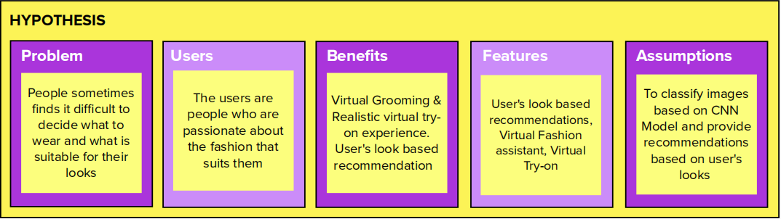
MURAL HYPOTHESIS

Slide 6
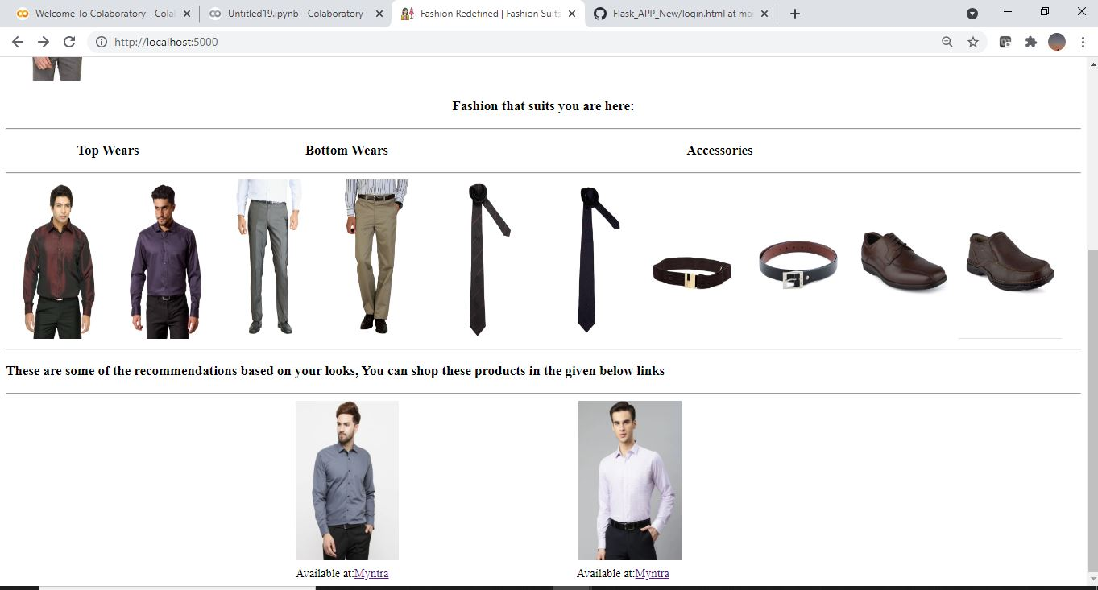
SAMPLE AND RESULTS

Slide 7
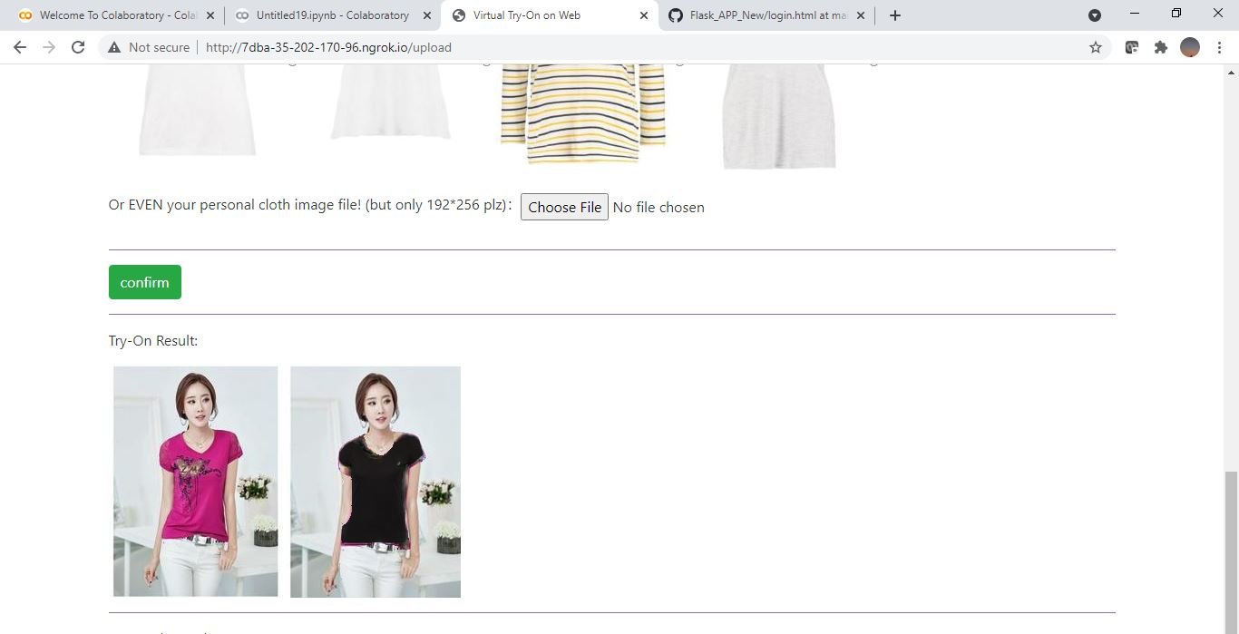
SAMPLE AND RESULTS

Slide 8
ADVANTAGES
It offers a cross-platform feel where it provides suggestions from various e-Commerce websites and platforms along with its navigation links.
Enables the user to try out the costume of their own interest before buying.
It acts as an complete package for user’s who are not aware of fashion trends.
Suggestions from chatbot also provides navigation links to other platforms, so that suggestions along with buying those products will be effective.

Slide 9

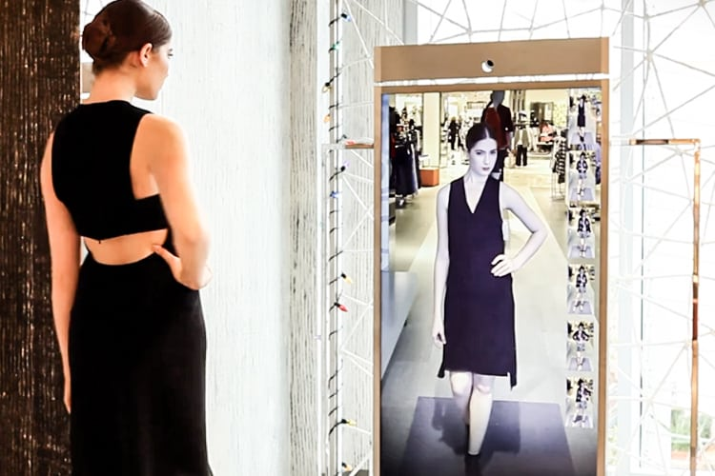
FUTURE ENHANCEMENT
Creating an 3D chatbot with voice enabled technologies.
Virtual try-on is made realistic by using kinetic sensor.
3D chatbot
Virtual Try-on

Slide 10
QUERIES
What is the model accuracy?
How do chatbot provide suggestions?
What is the chat bot’s input?
How virtual try on can be achieved?

Slide 11
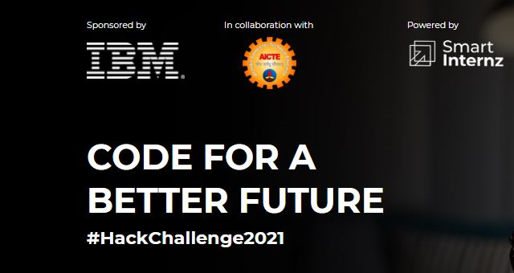

THANK YOU

